Slide 1
PASSWORD STRENGTH DETECTION
CSE 523 - MACHINE LEARNING
Course Instructor - Prof. Mehul Raval
NAME | ENROLLMENT NUMBER
ZALAK SHAH | AU2040217
AVINASH RAVAL | AU2040031
FREYAL SHAH | AU2040228
FREYA MODI | AU2040222

Slide 2
INTRODUCTION
Passwords secure online accounts and sensitive information, but weak ones risk user data and privacy.
Reliable and efficient ways are needed to measure password strength and help users create stronger ones.
Comparing existing machine learning models can improve accuracy and analysis.

Slide 3
PROBLEM STATEMENT
The project involves comparing machine learning models to accurately predict password strength based on factors like length and complexity, with the goal of creating stronger passwords to defend against cyber attacks.

Slide 4
EXISTING WORK
1."A Machine Learning Approach to Password Strength Meters" by Ingmar Baumgart et al. This paper proposes a machine learning-based approach to password strength estimation and evaluates its performance against other methods. The authors use a dataset of 70,000 passwords and compare the performance of logistic regression, decision trees, and random forests.
2."Using Machine Learning to Predict the Strength of Passwords" by Ravi Sahita et al. This paper proposes a machine learning-based approach to password strength prediction using various features such as password length, character types, and common words. The authors evaluate their approach on a dataset of 1.8 million passwords and report an accuracy of 88.5%.
3."A Comparative Study of Password Strength Estimation Techniques" by Julien Freudiger et al. This paper compares different methods for password strength estimation and identifies their strengths and weaknesses. The authors evaluate various methods, including Markov models, neural networks, and decision trees, on a dataset of 1.5 million passwords.
These works provide valuable insights into the problem of password strength prediction using machine learning and can serve as a basis for developing new and improved approaches.

Slide 5
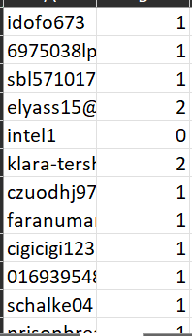
INITIAL APPROACH
DATASET:
We found a Kaggle dataset with over 6,69,880 entities
To train a model, we’ll input some prior knowledge in form of dataset so our model can learn from it.
Thus having a big dataset was helpful in terms of accuracy towards prediction.

Slide 6
ALGORITHM USED
DECISION TREE CLASSIFIER:
Decision tree classifier is a popular machine learning algorithm that creates a tree-like model to predict the class label of a given input. It recursively splits the dataset based on the most significant feature, and each node represents a decision based on that feature until it reaches the final decision or leaves.
At each node of the tree, the algorithm selects the feature that best separates the data into different classes based on a certain metric, such as information gain or Gini impurity. The feature with the highest information gain or lowest Gini impurity is selected as the splitting criterion, and the data is partitioned into subsets based on its values.

Slide 7
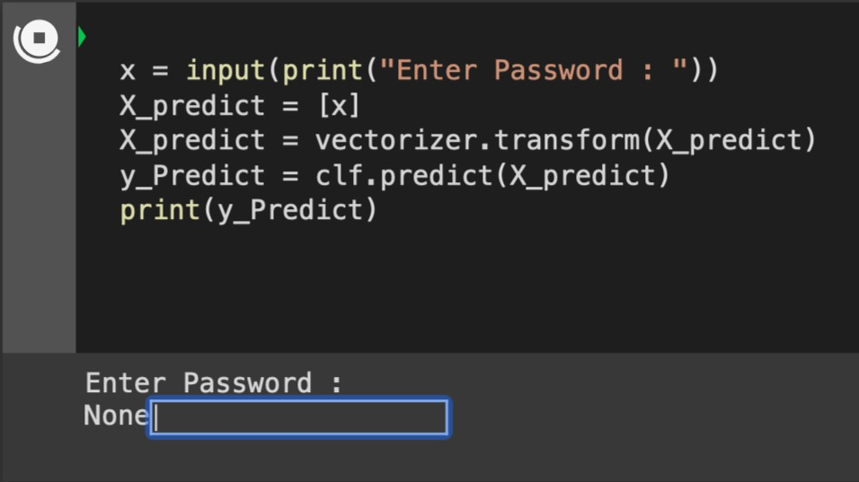
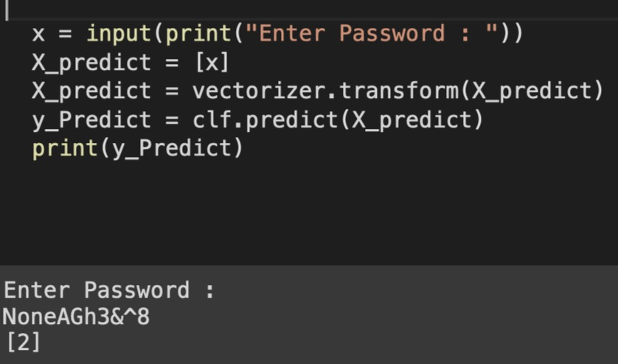
RESULTS:

Slide 8
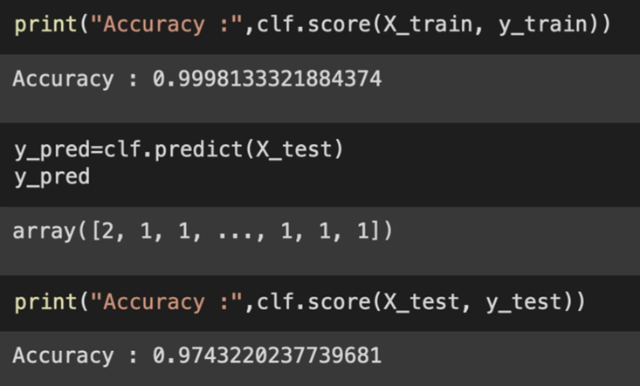
Accuracy for training set and test set

Slide 9
FUTURE WORK
Further , we will try to implement Logistic Regression on the same data set and compare the accuracy measure with the Decision Tree.
Then, we’ll try to make a webpage to implement the code in efficient manner.

Slide 10
INDIVIDUAL CONTRIBUTION:
NAME | CONTRIBUTION
Zalak Shah | Implemented code and worked on dataset
Freyal Shah | Implemented code and analyzed results
Freya Modi | Collection of information and understanding algorithm
Avinash Raval | Reviewed existing body of work and worked on report

Slide 11
REFERENCES
[1] B. bansal, “Password strength classifier dataset,” Kaggle, 27Jun-2019.
[2] Farooq, U. (2020, December). Password Strength Analysis. International Journal of Engineering Research & Technology, 9(12), 6.
[3] Building a Password Strength Classifier Model Using Machine Learning. (2022, January 26). Section.io. Retrieved March 11, 2023.

